Slide 1
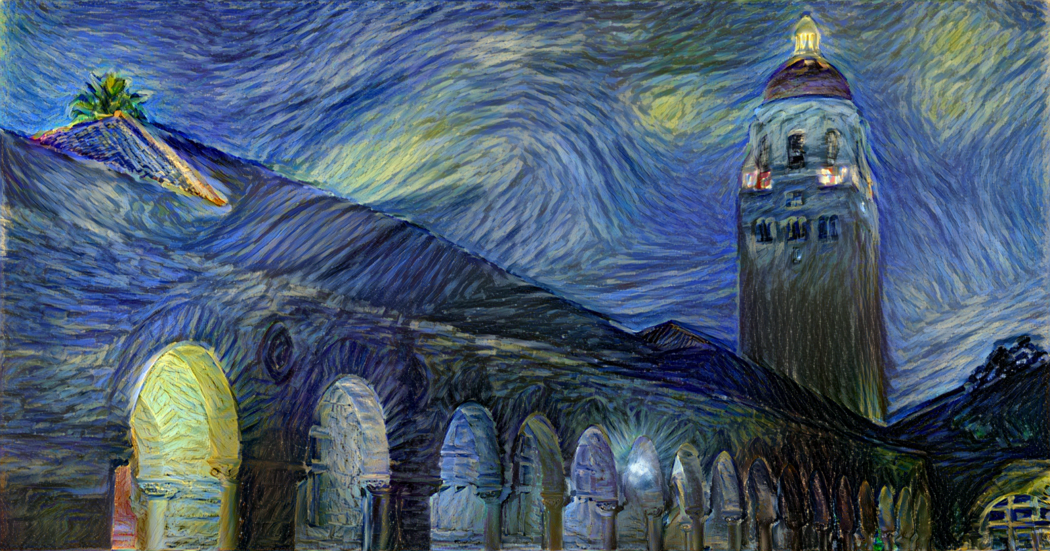
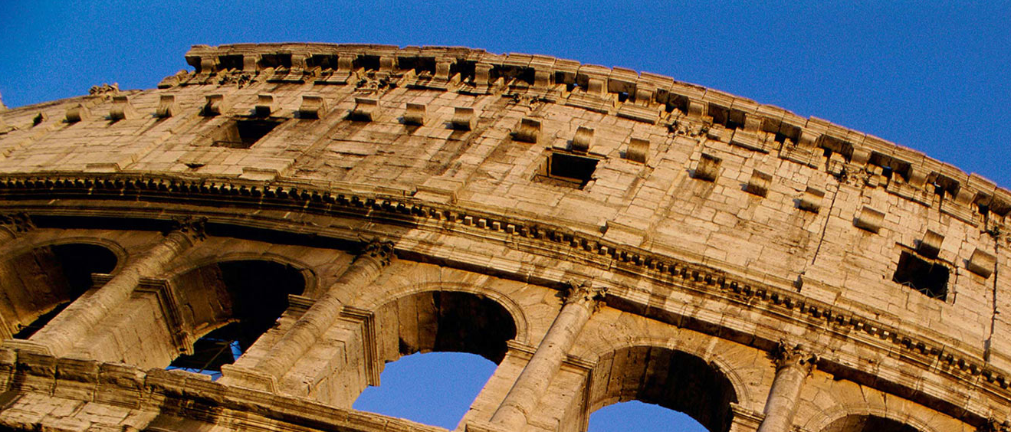
Image Style Transfer
Xiangcheng Shen, Dong Fang, Rui Yin, Messi Tu

Slide 2
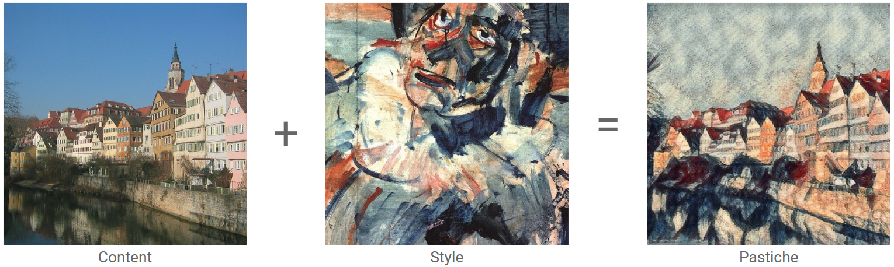
What is Image Style Transfer?
Transfer the style from one image to the content of another image

Slide 3
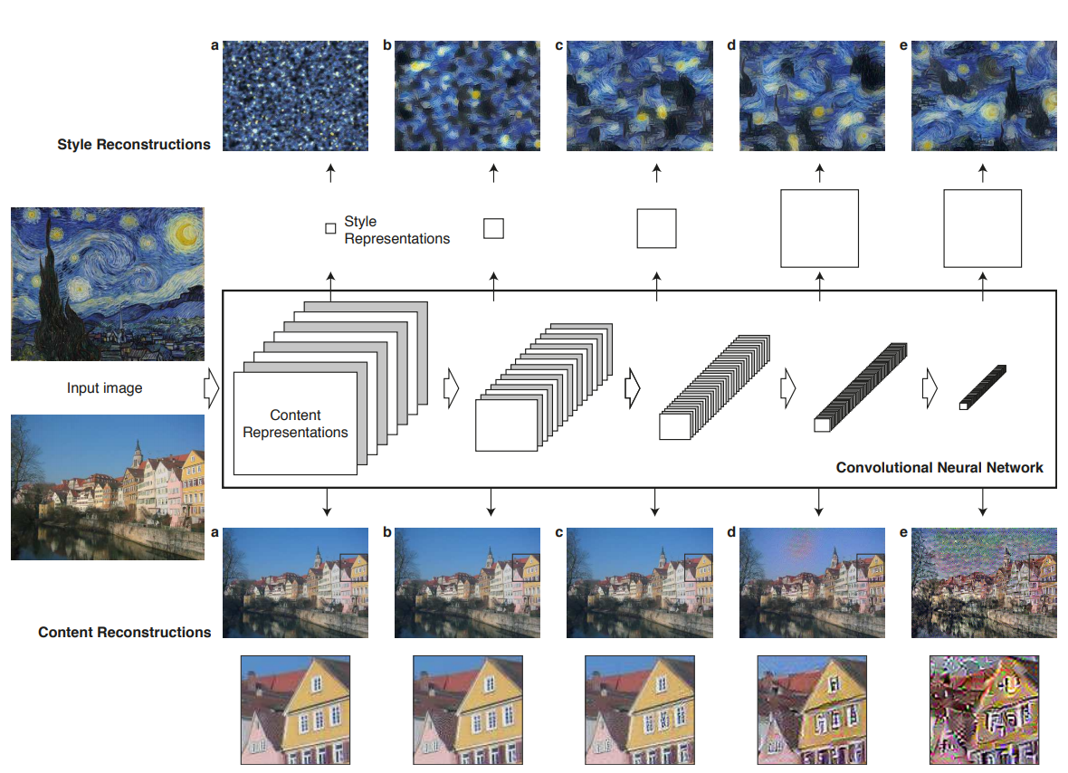
How do we
implement it

Slide 4
How do we
implement it
Content Reconstructions and Style Reconstructions done by VGG 16 network
A given input image is represented as a set of filtered images at each processing stage in Convolutional Neural Network
A Neural Algorithm of Artistic Style

Slide 5
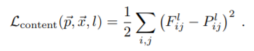
How do we implement it?
Extract content and style by loss functions
Content Loss Function:
squared-error loss between the two feature representations
To preserve the contours of the content image, we need to minimize the difference between the features that are activated for the content image and for the mixed image

Slide 6
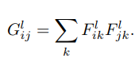
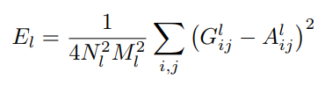
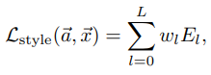
Gram-matrix:
It measures the features activated simultaneously in a given layer, as an activation pattern.
Style Loss Function:
Minimizing the difference of activation pattern of style image and mixed image preserves the color and texture of the style image.
How do we implement it?

Slide 7
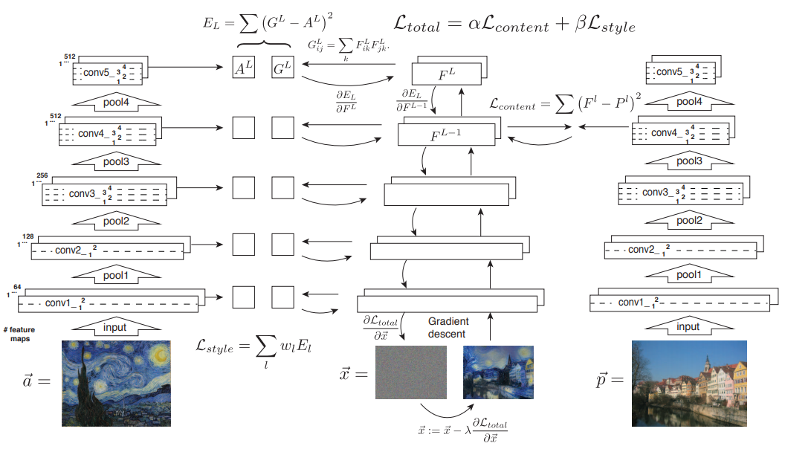
Style Transfer
Mix content image and style image
Adjust the weight of content and style
Denoise the mixed image
How do we
implement it

Slide 8
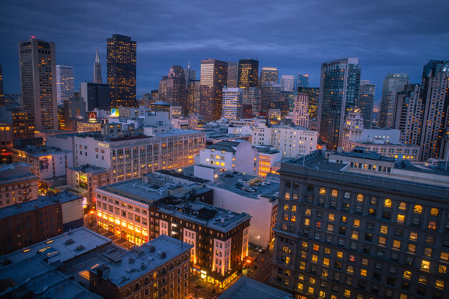

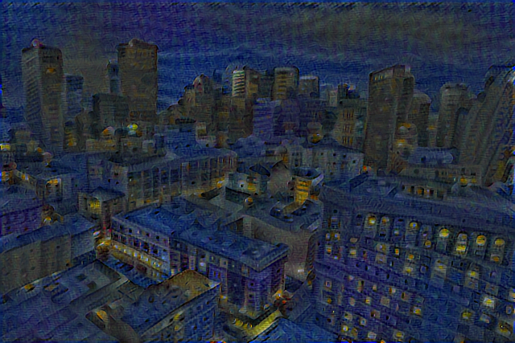
Image
Style
Result
Results

Slide 9
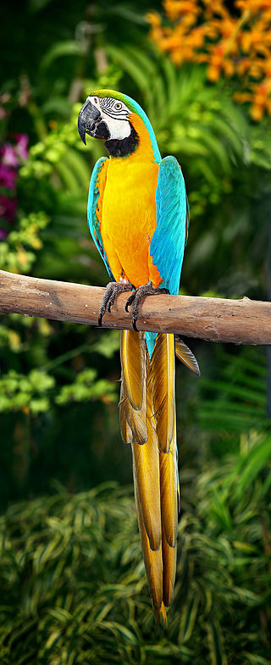
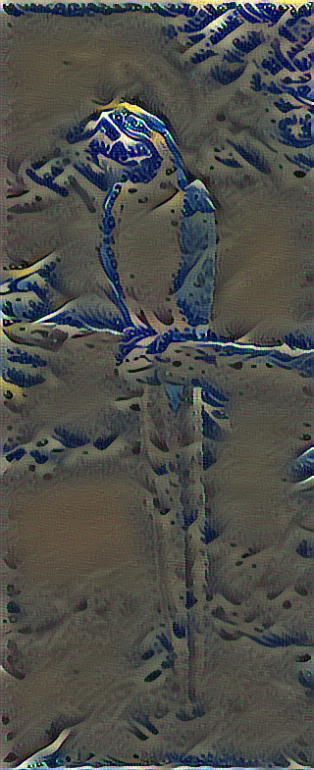
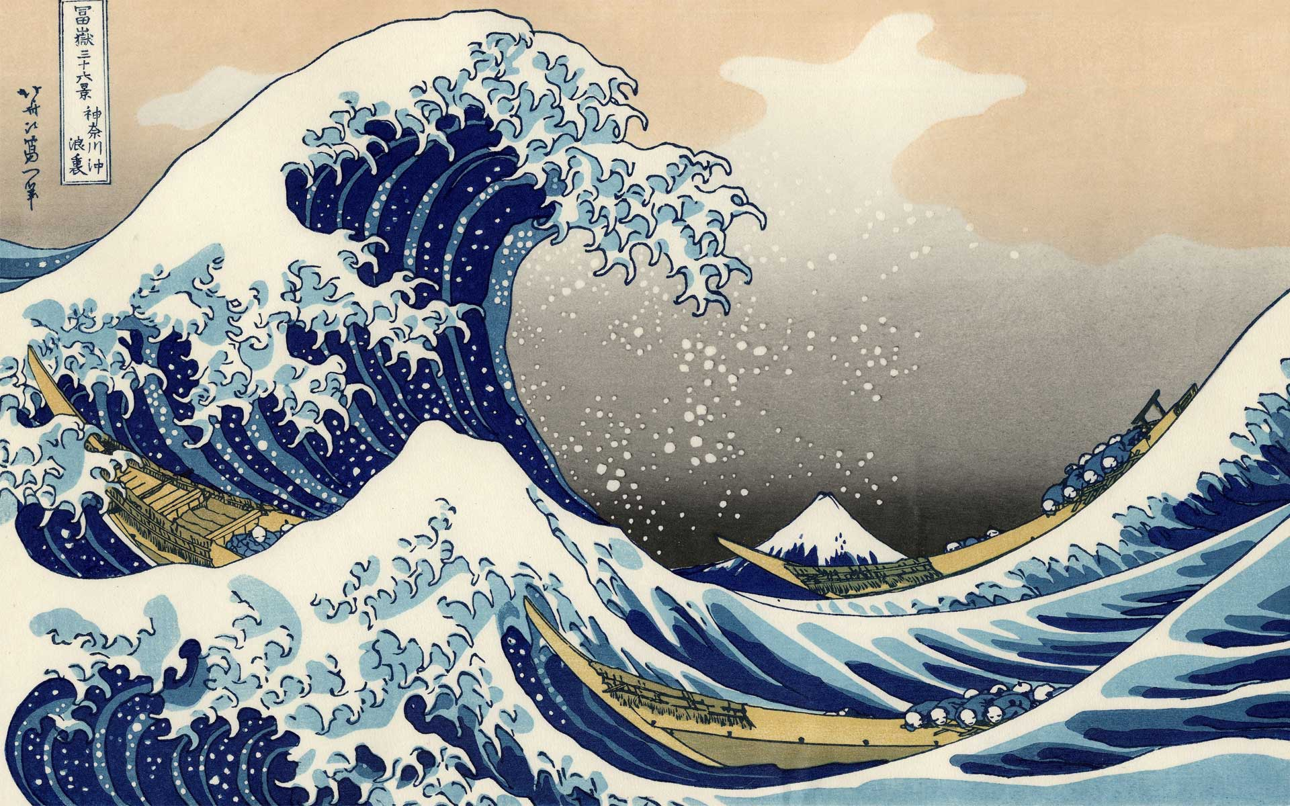
+
=
Results

Slide 10
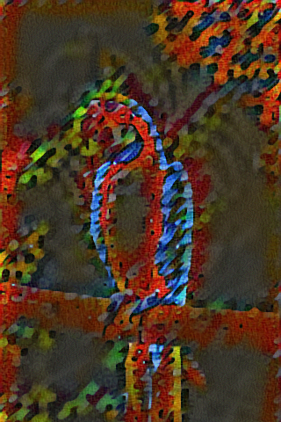
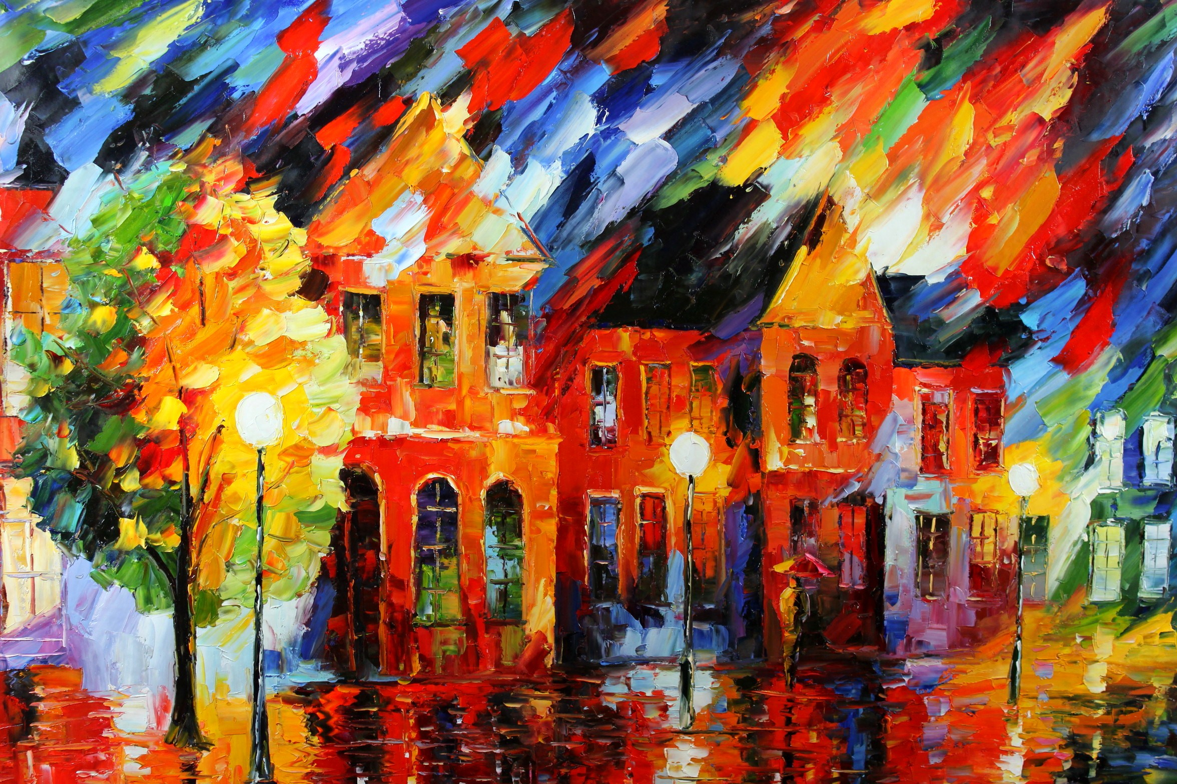
Results

Slide 11

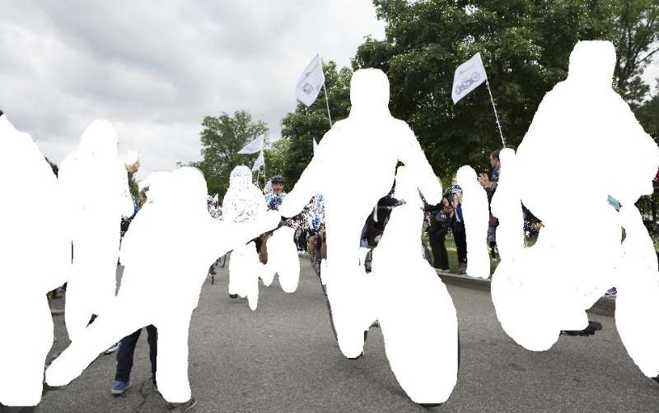
Portion Selection
We selected several part that we want to implement the style transfer first

Slide 12

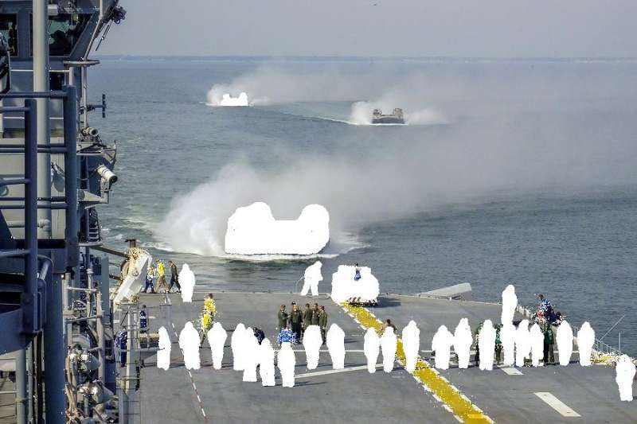
Portion Selection
We selected several part that we want to implement the style transfer first

Slide 13
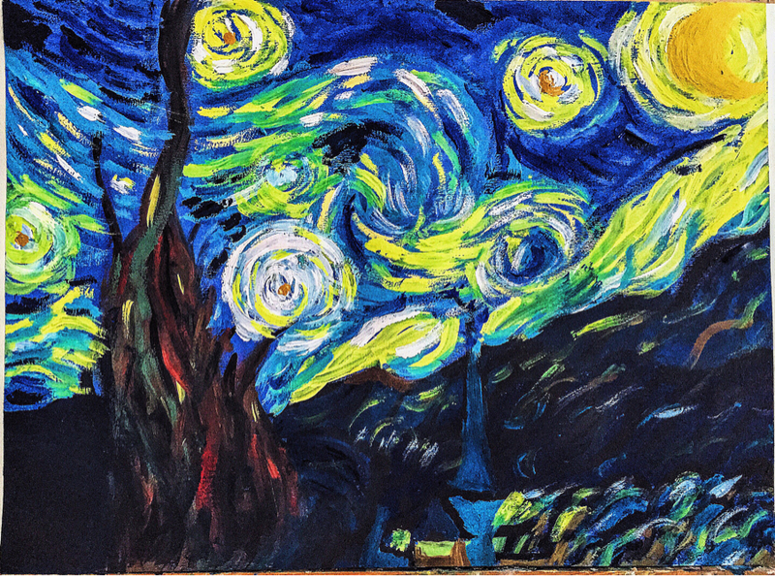
Style Image

Slide 14
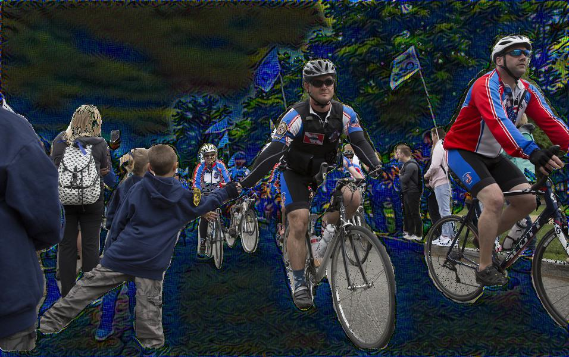
Results

Slide 15
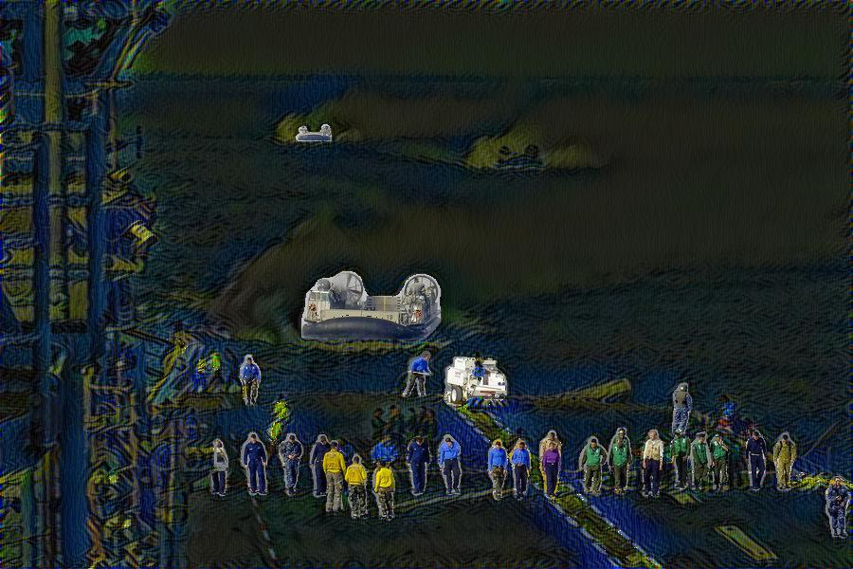
Results

Slide 16
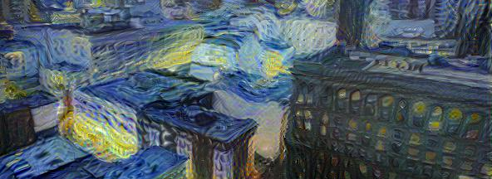
Shortcomings
Relatively Slow Process: It took at least several minutes to generate a satisfying result
Different content images and style images require different weights to generate good results
Results are not as great as online examples

Slide 17
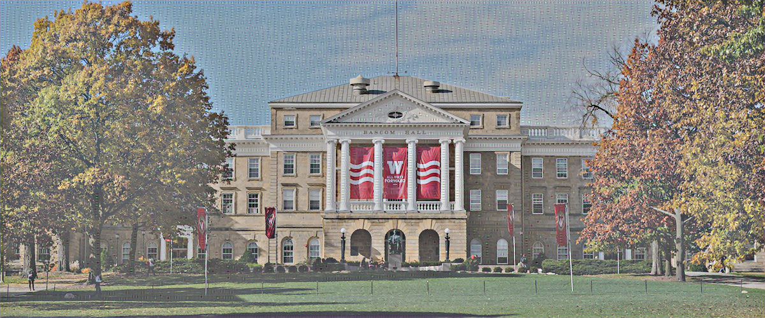
References:
Gatys, L. A., Ecker, A. S., & Bethge, M. (2016). Image Style Transfer Using Convolutional Neural Networks. 2016 IEEE Conference on Computer Vision and Pattern Recognition (CVPR). doi:10.1109/cvpr.2016.265
Artistic Style Transfer with Convolutional Neural Network. (2018). Retrieved from https://medium.com/data-science-group-iitr/artistic-style-transfer-with-convolutional-neural-network-7ce2476039fd
https://github.com/Hvass-Labs/TensorFlow-Tutorials
https://github.com/fzliu/style-transfer

